Slide 1
Routes in a React app
2021

Slide 2
Routing in React
App Structure

Slide 3
Routing with React

Slide 4
react-router
React is an eco system
„react“ is a View-Library – it has no Routing
We need anothoer library for Routing– „react-router“

Slide 5
What is Routing in a SPA
"Single-Page" Apps do not load different „index.html“ pages for different URLs
By changing the URL, we „navigate“ locally, and respond by changing the component(s) shown
Or in the other way, we can have a component change the URL (so that other components can be shown)

Slide 6
How does a URL work in SPAs
We can modify a URL (without actually navigating) via HTML5 History API (pushState, replaceState, popState)
This way we can control what the browser does for us, without actualy loading pages from the web server
oder nach einer Ressource sucht, sodass die Benutzeroberfläche mit der URL synchron bleibt.
Example: try this in your chrome console
history.pushState({
urlPath:'/this-page-should-not-be-there’
},
”This page is not actually loaded“,
'/this-page-should-not-be-there')

Slide 7
404 Redirect
What happens at a page reload though?
Our app is not yet loaded, so the browser requests the actual shown URL (/this-page-should-not..) from the server
This URL is most probably likely not existing on the server and we get a 404 error.
That means, that for most SPAs to work properly, we need to redirect all 404 pages to load the original index.html with the SPA app itself instead.
The app will then read the URL and resolve which „page“ should be loaded (or which component to show)

Slide 8
URL Fragment – Hash Routing
Sometimes we do not have an option to touch the URLs or web server config or 404 redirects
In this case, we can use „hash routing“
http://example.com/path?query=string#navigate-here http://example.com/path?query=string#navigate-there http://example.com/path?query=string#fragment-is-JUST_FOR_ME

Slide 9
URL vs Hash router Router example
http://example.com/cars
Server gets http://example.com/cars
Server searches for /cars/index.html
There is no cars/ directory at all
404 💣
http://example.com/#/cars
Server gets only - http://example.com/
It just loads the regular index.html
But our client-side JavaScript sees and can access the #cars bit

Slide 10
What is routing in SPAs anyway? What does it actually mean?
"Home" - `/` - `<Home/>` "Todos" - `/todos` - `<TodosManagement/>` "Todo" - `/todos/:todo` - `<Todo/>`

Slide 11
How can I show only certain components in the App component, depending on the URL??
export const App = () => { const [page, setPage] = useState(window.location.pathname); const go = (where: string) => { history.pushState({}, where, `${window.location.origin}${where}`); setPage(where); }; return ( <div className="app"> <nav> <a className="link" href="#" onClick={go(“/home")}> Home </a> <a className="link" href="#" onClick={go(“/users")}> Users </a> </nav> {page === “/home" ? <Home /> : null} {page === “/users" ? <Users /> : null} </div> ); };

Slide 12
Should every app attach URL listeners, manage it‘s state, update it and keep track of it all?
The answer is, quite expectedly, no.

Slide 13
There’s an app for everything
Everything library

Slide 14
There’s gotta be one serving as a react-router.
react-router

Slide 15
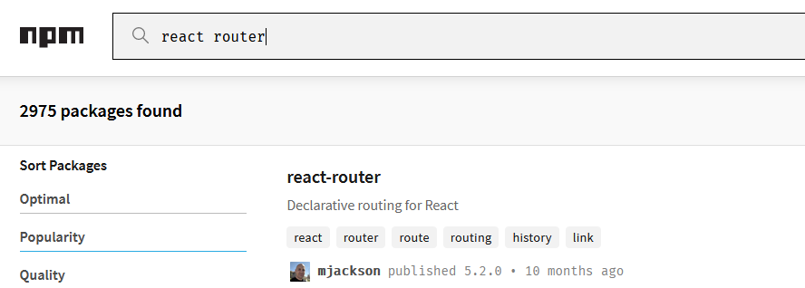
And not just one

Slide 16
We use React-Router to navigate around the app
There are two router libraries: react-router-dom and react-router-native
npm install react-router-dom

Slide 17
react-router
We’re usually using one of the following variants:
react-router-dom
react-router-native

Slide 18
React Router offers these components:
import { BrowserRouter, // or HashRouter Switch, Route, Link } from "react-router-dom";

Slide 19
What does each of them mean?
BrowserRouter
Switch
Route
Link

Slide 20
BrowserRouter (or we just call it Router)
It is a provider for all the router-related components, hooks etc.
If we want to use react-router in an app, we have to wrap all the underlaying components in a browser-router.

Slide 21
A simple example
const App = () => { return ( <BrowserRouter> <Route path="/" component={Home} /> <Route path="/todos" component={Todos} /> <Route path="/todos/:id" component={Todo} /> </BrowserRouter> }

Slide 22
What does „Route“ here mean?
const App = () => { return ( <BrowserRouter> <Route path="/" component={Home} /> <Route path="/todos" component={Todos} /> <Route path="/todos/:id" component={Todo} /> </BrowserRouter> }

Slide 23
Let’s compare our apps now?
export const App = () => { const [page, setPage] = useState(window.location.pathname); const go = (where: string) => { history.pushState({}, where, `${window.location.origin}${where}`); setPage(where); }; return ( <div className="app"> <nav> <a className="link" href="#" onClick={go(“/home")}> Home </a> <a className="link" href="#" onClick={go(“/users")}> Users </a> </nav> {page === “/home" ? <Home /> : null} {page === “/users" ? <Users /> : null} </div> ); };
const App = () => { return ( <BrowserRouter> <Route path="/" component={Home} /> <Route path="/todos" component={Todos} /> <Route path="/todos/:id" component={Todo} /> </BrowserRouter> }

Slide 24
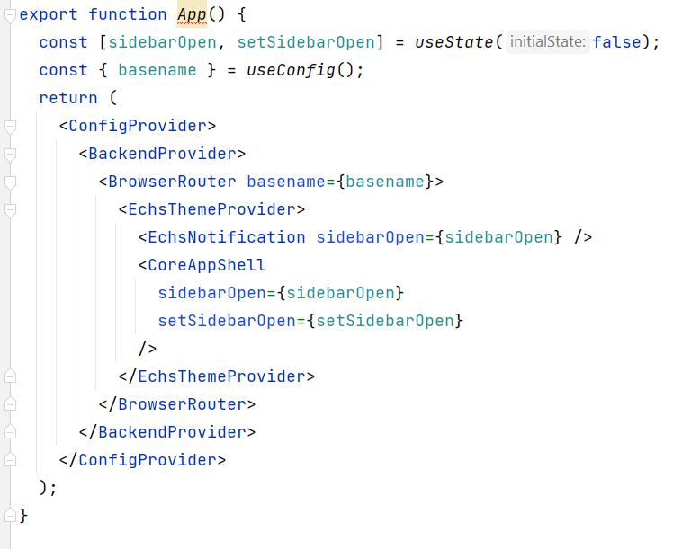
Example out of a real, live projects
const theme = 'light'; export const App = () => ( <ThemeProvider theme={theme}> <CssBaseline> <HashRouter> <UserProvider> <Messages /> <Navigation /> <LoadingIndicator /> <MainArea> <Routes /> </MainArea> </UserProvider> </HashRouter> </CssBaseline> </ThemeProvider )
There he is!

Slide 25
Link component
<nav> <ul> <li> <Link to="/">Home</Link> </li> <li> <Link to="/about">About</Link> </li> <li> <Link to="/dashboard">Dashboard</Link> </li> </ul> </nav>

Slide 26
Which component gets rendered when?
<nav> <ul> <li><Link to="/">Home</Link></li> <li><Link to="/todos">Todos</Link></li> <li><Link to="/todos/new">New Todo</Link> </li> </ul> </nav> <Route path="/" component={Home} /> <Route path="/todos" component={TodosProvider} /> <Route path="/todos/new" component={NewTodo} />

Slide 27
If a Route path matches the URL, the component gets rendered. EVERY component matching it gets rendered.
URL: /todos/new
Which Component(s): ???
<Route path="/todos" component={TodosProvider} /> <Route path="/todos/new" component={NewTodo} />

Slide 28
Exact Path
const App = () => { return <div> <Route path="/" component={Home} /> <Route exact path="/todos" component={Todos} /> <Route exact path="/todos/new" component={NewTodo} /> </div>; }

Slide 29
What about user-ids, post-ids, other path parameters?
const App = () => { return <div> <Route path="/" component={Home} /> <Route exact path="/todos" component={Todos} /> <Route exact path="/todos/1" component={Todo} />
<Route exact path="/todos/2" component={Todo} /> <Route exact path="/todos/3" component={Todo} />
<Route exact path="/todos/4" component={Todo} /> <Route exact path="/todos/5" component={Todo} />
<Route exact path="/todos/6" component={Todo} /> </div>; }
This might generate a lot of pull requests if we start adding a path each time we add a todo in the app?

Slide 30
Path parameters FTW!
const App = () => { return <div> <Route path="/" component={Home} /> <Route path="/todos" component={Todos} /> <Route path="/todos/:id" component={Todo} /> </div>; }

Slide 31
But to only render one component, we need a Switch
const App = () => { return <div> <Switch> <Route path="/" component={Home} /> <Route path="/todos" component={Todos} /> <Route path="/todos/:id" component={Todo} /> <Switch> </div>; }

Slide 32
Okay now, but how do we get that URL Parameter?
const Todo = () => { const todoId = ??; const getTodo = () => { axios.get('/api/todos/' + ??); } const deleteTodo = () => { axios.delete('/api/todos/' + ??); } return <section className="todo-card"> <h3>{todo.title}</h3> <p>{todo.text}</p> <div className="actions"> <button onClick={deleteTodo}>Delete</button> </div> </section> }

Slide 33
useParams() – a hook to get the (path and other) parameters
const Todo = () => { const { id } = useParams(); const [todo, setTodo] = useState({}); const getTodo = async () => { axios.get(`/api/todos/${id}`) .then((res) => { setTodo(res); }); } return <section className="todo-card"> <h3>{todo.title}</h3> <p>{todo.text}</p> ... </section> }
const App = () => { return <div> <Switch> <Route path="/" component={Home} /> <Route path="/todos" component={Todos} /> <Route path="/todos/:id" component={Todo} /> <Switch> </div>; }

Slide 34
useHistory() – a hook to navigate programatically
const Todo = () => { ... const history = useHistory(); const deleteTodo = () => { axios.delete(`/api/todos/${id}`) .then(() => { // navigate away history.back(); // to go to previous page history.push('/todos'); // to go to a specific page }); } return <section className="todo-card"> <h3>{todo.title}</h3> <p>{todo.text}</p> <button onClick={deleteTodo}>Delete</button> </section> }

Slide 35
Nested Routes
<BrowserRouter> <div className="App"> <header className="App-header"> <nav> <Link to="/todos">Todos</Link> <Link to="/users">Users</Link> </nav> </header> <main> <Switch> <Route path="/todos" component={Todos}/> <Route path="/users" component={Users}/> </Switch> </main> </div> </BrowserRouter>

Slide 36
How can we have nested Routes?
const Todos = () => { const { path, url } = useRouteMatch(); return <div> <ul> <li> <Link to={`${url}`}>All Todos</Link> </li> <li> <Link to={`${url}/new`}>New Todo</Link> </li> </ul> <Switch> <Route exact path={path}><TodoList/></Route> <Route exact path={`${path}/new`}><NewTodo/></Route> <Route path={`${path}/:id`}><Todo/></Route> </Switch> </div> }
<BrowserRouter> <div className="App"> <header className="App-header"> <nav> <Link to="/todos">Todos</Link> <Link to="/users">Users</Link> </nav> </header> <main> <Switch> <Route path="/todos" component={Todos}/> <Route path="/users" component={Users}/> </Switch> </main> </div> </BrowserRouter>

Slide 37
Demo
We will set up a User Management App with routing.
Let’s set up a Home component for the Route /
Set up UserView component for Users feature (!)
Set up Routing with Home, UserList and UserCard

Slide 38
Practice
Add a simple Posts page to our UserManagement app (a list of posts)
Navigating to it, we need to load posts from the placeholder API (but not sooner!)
As we open the list of posts, we can click on an individual post
When we open a single posts, we show that posts and three buttons: “previous”, “next” and “all posts”
These buttons navigate to the appropriate page in the app
We also have a link to navigate to the author of the post

Slide 39
What else is there with routers?
Query Parameters und other Router Hooks
Code Splitting - setup modules as lazy modules, and only ever load code if it‘s requested (e.g. don‘t load the Posts component until we actually click on Posts in nav)
Adjusting the scroll behavior – navigate to a particular user-card, row in a table, position on the page and keep this position even if the user reloads the page
Adjust the context – let‘s wrap the entire feature under a URL, and then set up a context for that URL for sharing the state.

Slide 40
Further Information
React Router

Slide 41
React Routing
react-router-dom
App is wrapped in a <Router> component (BrowserRouter or HashRouter)
We‘re setting navigation between components and pages with a <Link to>
We‘re usually splitting the app in various „features“, and we only have a few top-level routes
Each „feature“ has a sort of a container component that manages further routing within that feature
The components can then pick up e.g. path parameters with the router hooks, and everything else works as before (e.g. useState, useEffect, or context API)

Slide 42
Questions?

Slide 43
App structures in react
How do we organize all the files – all the different component types and hooks etc – in a folder structure in a project? Each file directly under the src/ folder or?

Slide 44
“move files around until it feels right”
File structure: “move files until it feels right” - Dan Abramov

Slide 45
React does not mandate any particular way to provide an app with structure (nor does it provide much guidance)
Two usual ways to sort it out:
Folder per component type (hooks, components, providers, models, …)
Folder per Route
Folder per Feature
* - from React Docs
Practically the same principle

Slide 46
Folder per file type
api/ BaseAPI.js UserAPI.js TodoAPI.js hooks/ use-users.js use-todos.js components/ Button.jsx UserCard.jsx UserCard.css UserList.jsx UserList.css TodoCard.jsx TodoList.jsx
TodoProvider.jsx Toolbar.jsx util/ format-dates.js sort.js
store/
actions.js
reducers.js

Slide 47
Folder per file type
Grouping similar files together
Simple approach, super-simple decission making on e.g. a new file or finding a file
It gets complicated if the number of files grows
Works okay for smaller projects

Slide 48
Folder per Feature
common/ BaseAPI.js Button.jsx Toolbar.jsx todos/ use-todos.js TodoAPI.js TodoCard.jsx TodoList.jsx
TodoProvider.jsx
user-actions.js
user-reducers.js users/ use-users.js UserAPI.js UserCard.jsx UserCard.css UserList.jsx UserList.css
x

Slide 49
Folder per Feature
One Business Function (feature) per folder
Independant from approach, patterns we use, routing, works in every app
We can further set up subfolders per e.g. file type or per further features
Mostly used in mid-scale to bigger projects (like ours)

Slide 50
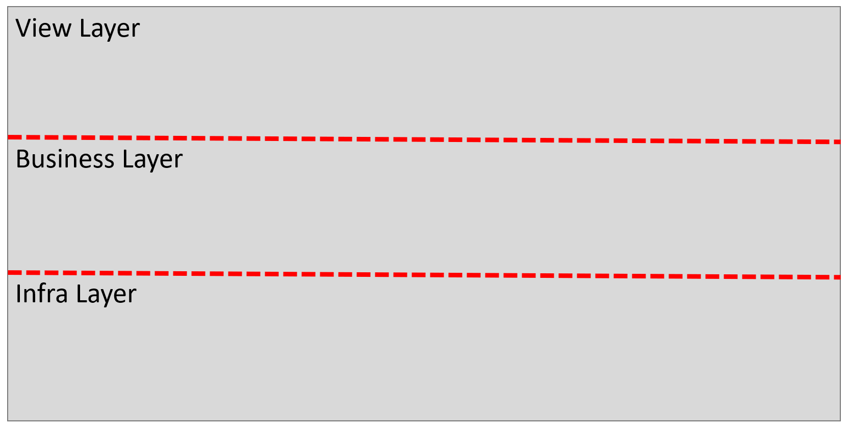
Layers in an app

Slide 51
Folder per layer
View Layer: components
Business Layer (business logic): contexts, Custom Hooks
Infra Layer: external resources (API-access, authentication, sessionStorage,…)
todos/ view/ TodoCard.jsx TodoList.jsx api/ TodoAPI.js use-todos.js ...

Slide 52
App Structure
Application-wide contexts in one folder (AuthProvider, BackendProvider, UserProvider, ThemeProvider, Navigation and similar things)
Shared components in a global src/components/ folder with further substructure (e.g. tables, datepickers and other widgets)
Shared services and utilities in a src/shared or similar folder
Individual features in src/features/, src/pages/ or similar folder.

Slide 53
Further topics in the next training (React architecture basics)

Slide 54
Questions?

Slide 55
Thank you, you can go write great todo apps now ☺

